Slide 1
IoT Enabled Automatic Access Control System with COVID Detection
Mentor :- Dr. Subhankar Bhattacharjee
Presented by: -
Abhirup Bhattacharyya
Katha Ghosh
Siddhartha Rakshit
Aanchal Gupta

Slide 2
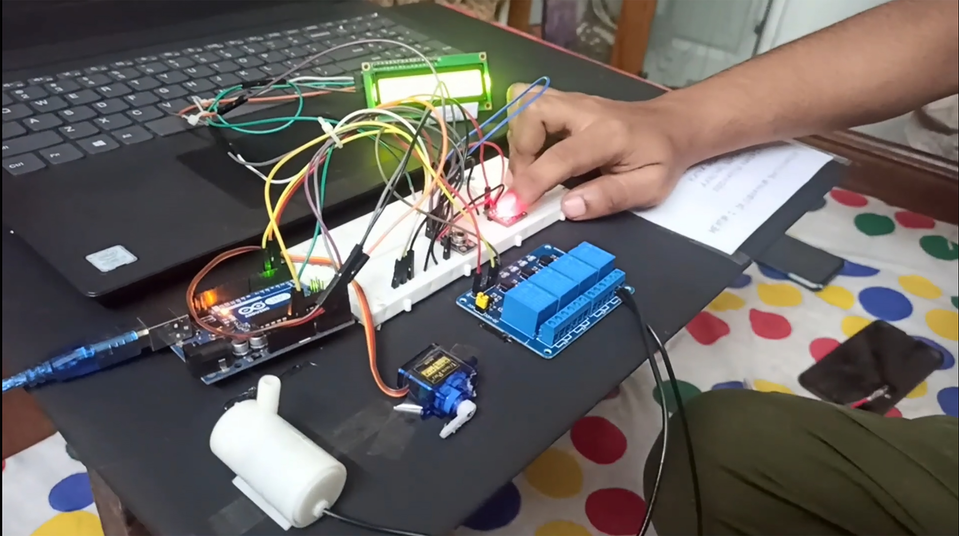
INTRODUCTION
In the present day, automation and IoT has reached some stupendous extent. Thus bridging this two we have come up with an advance technology for health monitoring and maintaining record name as “IoT enabled Automatic Access Control System with COVID Detection”.
Fig. Picture demonstrating the final prototype

Slide 3
Literature Survey
2019 – Present ( SARS COVID-19 PANDEMIC)
Live monitoring of patients using IoT and other medical & engineering advancements
1918 – 1920 (SPANISH FLU)
Lasted for two long years due to lack of advancements in medical science
1817 - 1824 (CHOLERA PANDEMIC IN ASIATIC REGION)
A worst hit pandemic recorded in human history
The effect of the pandemic did not affected much as compared to the other due to these advancements and early dosages of vaccine.
Rapid 14 days Quarantine Treatment of suspected patients
This pandemic almost killed one-third of the entire human population around the globe
A bulk of population around the world wiped out due to lack of medical treatment.

Slide 4
Research and Analysis based on Literature Survey
Proposed µC – ATmega328p + ESP 32 (for IoT purpose)
Programming language – Embedded C/C++
Processing of the algorithm and pseudo code based on user’s proposition
PCB fabrication – using Altium and EasyEDA
Testing and Debugging of the proposed solution
Planning – development of solution to this pandemic issue
Circuit Designing – Based on available analog parts
Simulation of the prototype along with assembling
OUTPUT
IoT enabled Automatic Access Controlled Gateway Device

Slide 5
Sensor(s) and Microcontroller
ESP 32 (Wi-fi Board)
MLX90614
Industry-scaled IR Temperature sensor
MAX30100
IR SpO2 and Heart-rate sensor
MCU8266 µC
ESP8266 has 32 bit architecture
Works with I²C communication
Works with I²C communication
ATmega328p (µC)
Uses ATmega328p µC
Uses RISC architecture
ESP32 is preferred over it due to its IoT enabling feature
12V Relay Module
Works on the signal from µC
Triggers the sanitizer pump
Servo Motor
Works on the signal from µC
Water Pump
Works on the signal from relay module
Operates the Door mechanism
Triggers the sanitization process

Slide 6
Installation and Working Principal
The system is mounted on top of the entrance of area attracting massive crowd which checks :-
Body Temperature
Oxygen Level (SpO2)
BPM
Start
MAX30100
ATMega328p/ ESP32
Door Mechanism
Sanitizer Pump
Finish
Digital O/P
(triggers using servo motor)
Digital I/P
Processing Unit
MLX90614
1-channel Relay Module
Digital I/P
Digital O/P
(triggers the sanitizer pump)

Slide 7
Experimental Outcomes
Body Temperature normal range – (97ºF – 99ºF)
Oxygen Level (SpO2) normal range – (94% - 100%)
Test Case | Assertion | Reasoning | Door/Gate Mechanisms
1 | Body Temperature = Normal Oxygen Level (SPO2) = Normal | For normal body temperature and oxygen level, the chance that the person is affected or is a carrier of corona virus is negligible. Hence the person is allowed to enter. | Open
2 | Body Temperature = High Oxygen Level (SPO2) = Low | This is an accurate symptom for positive COVID-19 patient. The person is affected by the virus and thus the person will not be allowed to enter into the specific place. | Close
3 | Body Temperature = Normal Oxygen Level (SPO2) = Low | The person might not be affected by the corona virus, but the person might be an active carrier of the virus. In this case, there is a chance of infection for which the door remains closed. | Close
4 | Body Temperature = Normal Oxygen Level (SPO2) = High | This is also a case where the person might not be affected but is an active carrier of the virus. Hence the gate will remain closed. | Close

Slide 8

INTEGRATION of IoT
Values from the sensors are exchanged over the internet and stored in the cloud
Fetching values from MAX30100
Fetching values from MLX90614
Values are processed in ESP32 / STM32 (ARM based microcontroller)
Maintaining health records.
Survey and analysis.
Taking attendance in institution and work places etc.
After processing from the cloud
The values get uploaded and updated
At the same time in required database
Webservices like IFTTT, MQTT, Zigbee , amazon AWS etc. can be used to store and update sensor(s) values.

Slide 9
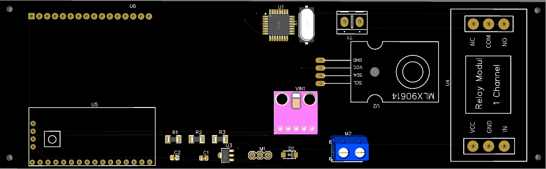
UNIQUE SELLING PROPOSITION
Fig. Industry ready PCB design
The unique selling point of this project are :-
We can replace the whole development board with the microcontroller ATmega328p / ESP32 and its components like quartz crystal, resistor, capacitors etc.
All the above modifications will minimize the production cost and furthermore the PCB design makes it industry ready.
Due to this industry standard PCB design, the entire project is very portable, sturdy and also easy mountable in precise location.

Slide 10
LIMITATIONS of the Sensor(s)
SL.NO. | Sensors | Limitations
1 | Infrared Temperature Sensor (MXL90614) | Not applicable | 3.6v - 5v | Ambient Temperature: -40°C to 125°C Object Temperature: -70°C to 382.2°C | ± 0.02° C
3 | Oximeter Sensor (MAX30102) | 7-9 seconds | 3.3v - 5v | Not applicable | SpO2 ± (1% to 2%)
Time Complexities | Working Voltage | Operating Temperature | Error

Slide 11
Statistical data representing the social impact of the prototype
*All the values that are taken into consideration for the preparation of the above demographic chart calculations, are experiment based.
Scale :-
* Each division on the Y-axis is a multiple of 5 million.
Demographic Estimation :-
As stated by WHO 10 people among 100 are tested to be Corona positive.
Now, after the installation of the prototype in real world scenario :-
Total candidates taken for consideration – 100
Total candidates actually found to be corona (+)ve – 10
Estimated success rate of the prototype – 7
Thus, we can validate that the efficiency of the prototype in real world scenario is – (70% - 80%)

Slide 12
MARKET ANALYSIS AND FUTURE SCOPE
Through proper analysis of the market it is concluded that the model is cost-effective, highly durable, portable, and mostly a one-time investment.
In the future, it can be used as a health monitoring device in hospital and other pharmaceutical labs
In the future through the introduction of fast pace technology and other advancements, ARM-based microcontrollers can be used to improve the sequential reading, writing and uploading speed of the database on the cloud server

Slide 13
CONCLUSION
The aim of this system is to automate the manual task along with maintaining a proper record of people entering the crowd places such as hospital, shopping complexes, bank, etc.
Through this proposition, we can move one step ahead towards building Smart City where live health monitoring facility will be a boon to human world, and is one of the renovation hotspots in this recent world.

Slide 14
Reference :-
Wu, Q.H., Buse, D.P., Feng, J.Q. et al. e-Automation, an architecture for distributed industrial automation systems. International Journal of Automation and Computing 1,17–25(2004).
Fizza, K., Banerjee, A., Mitra, K. et al. QoE in IoT: a vision, survey and future directions. Discover Internet Things 1(4), 1-14 (2021).
R. Costa, F. Pérola and C. Felgueiras, μLAB A remote laboratory to teach and learn the ATmega328p μC, 2020 IEEE Global Engineering Education Conference (EDUCON), pp. 12-13. Porto, Portugal (2020).
L. Gomes, S. Bogosyan, Current trends in remote laboratories, IEEE Trans. Ind. Electron., 56(12), 4744-4756 (2009).
L. N. Pintilie, T. Pop, I. C. Gros and A. Mihai Iuoras, An I²C and Ethernet based open-source solution for home automation in the IoT context, 2019 54th International Universities Power Engineering Conference (UPEC), pp. 1-4, Bucharest, Romania (2019).
David Kalinsky, Roee Kalinsky, Introduction to I²C, Embedded Systems Programming 14 (8), 1101-1105, (2001).
Jiménez-Naharro R, Gómez-Bravo F, Medina-García J, Sánchez-Raya M, Gómez-Galán JA. A Smart Sensor for Defending against Clock Glitching Attacks on the I²C Protocol in Robotic Applications. Sensors, 17(4), 677 (2017).
R. K. Megalingam, J. M. Varghese and S. A. Anil, Distance estimation and direction finding using I²C protocol for an auto-navigation platform, 2016 International Conference on VLSI Systems, Architectures, Technology and Applications (VLSI-SATA), Bengaluru, India, pp. 1-4 (2016).
J. Wan, Y. Zou, Y. Li and J. Wang, Reflective type blood oxygen saturation detection system based on MAX30100, 2017 International Conference on Security, Pattern Analysis, and Cybernetics (SPAC), pp. 615-619, Shenzhen, China (2017).
Pratama, R., Bangsa, I., & Rahmadewi, R. (2021). Implementation of the MAX30100 Heart Rate Sensor and the GSR Skin Conductance Sensor using the Arduino Microcontroller on a Stress Level Detector. JURNAL ILMIAH WAHANA PENDIDIKAN, 7(1), 161-168 (2021).
Rotariu, C. and Manta, V. Wireless system for remote monitoring of oxygen saturation and heart rate, computer Science and Information Systems (FedCSIS), 2012 Federated Conference on vol. 9, no.12, pp. 193-196, (2012).
Kerim Bedri Saçan, Gökhan Ertaş, MAX30100 SpO2/Nabiz Duyargasinin Performans Değerlendirmesi Performance Assessment of MAX30100 SpO2/Heartrate Sensor 2017 Medical Technologies National Congress (TIPTEKNO), 1-4, (2017).
A. N. Nazilah Chamim, J. Rinaldi, Y. Ardiyanto, I. Iswanto and A. Ma’arif, Heart Rate and Body Temperature Monitoring Based on Android Operating System, 2020 2nd International Conference on Industrial Electrical and Electronics (ICIEE), pp. 143-148, Lombok, Indonesia (2020).
F. Feng, Y. Yang, Y. Hu, W. Du and S. Chen, Airport Automatic Detection and Disinfection Channel based on Infrared Temperature Measurement, 2020 35th Youth Academic Annual Conference of Chinese Association of Automation (YAC), pp. 520-525, Zhanjiang, China (2020)

Slide 15

This project is selected in Proceedings of International Conference on Advanced Computing Applications, the Publisher of this proceeding is Springer Nature.
Our project will be reflected as Chapter No. 14 in their Book : Advs in Intelligent Syst., Computing, Vol. 1406

Slide 16

THANK YOU !!!

